Slide 1
CMPT 733 Data Preparation
Slides by:
Jiannan Wang
https://www.cs.sfu.ca/~jnwang/

Slide 2
Outline
1. Data Preparation Overview
2. Data Preparation Tasks

Slide 3

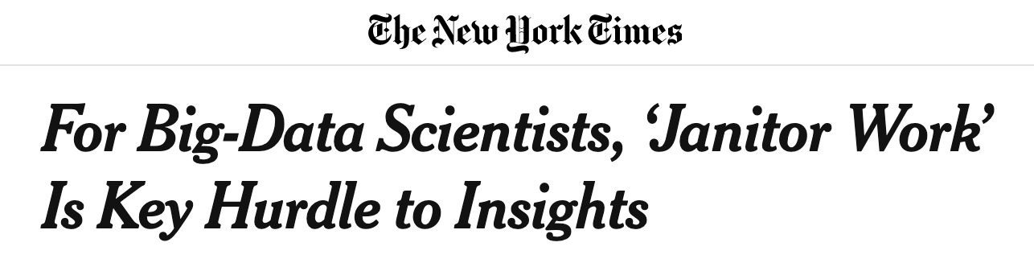




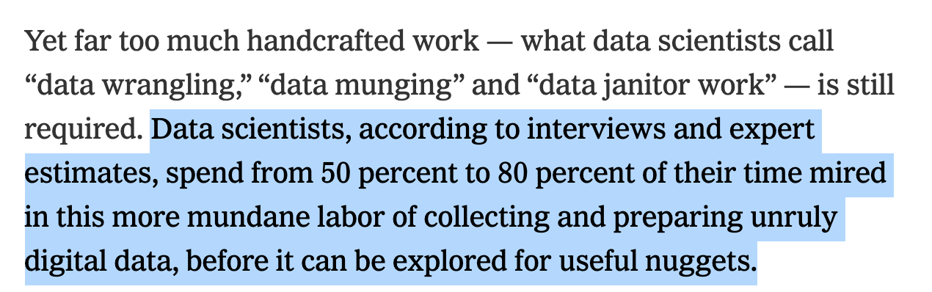
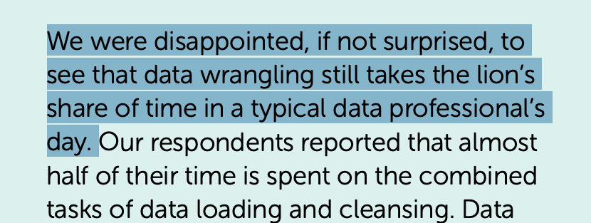
Data Preparation Is Still the Bottleneck!!!
2014
2020
https://www.nytimes.com/2014/08/18/technology/for-big-data-scientists-hurdle-to-insights-is-janitor-work.html
https://www.anaconda.com/state-of-data-science-2020

Slide 4
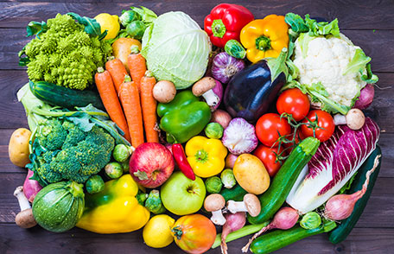

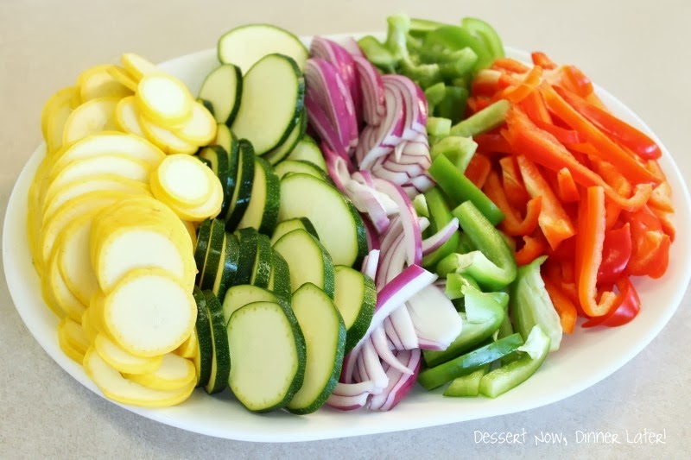

Why Is Data Preparation Hard?
Collection
Cleaning
Integration
Analysis
How much time is spent on preparation?
Too many small problems (e.g., standardize date, dedup address, etc)
Humans have different levels of expertise (in data science and programming)
Domain specific (finance, social science, healthcare, economics, etc.)

Slide 5
Human-in-the-loop Data Preparation
Three Directions
Spreadsheet GUI
Workflow GUI
Notebook GUI

Slide 6
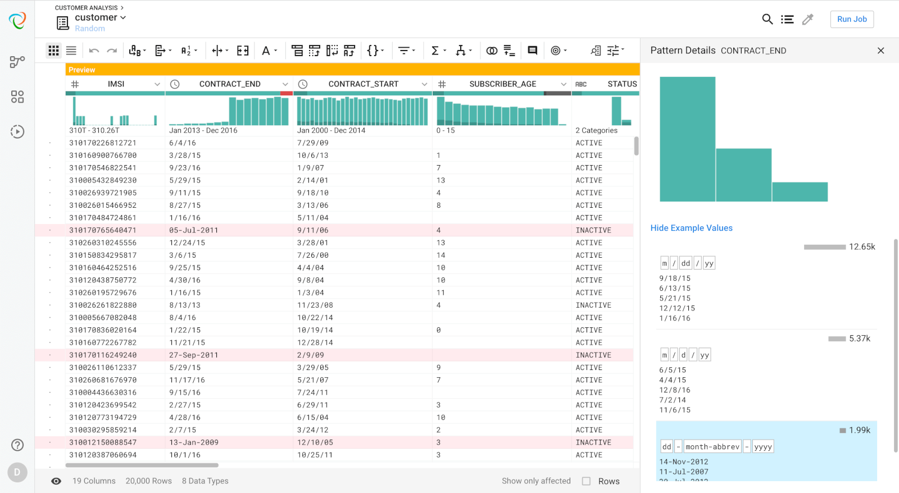
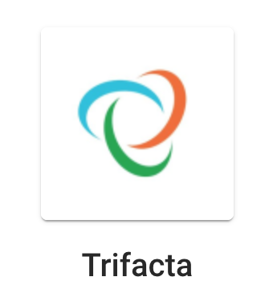
Spreadsheet GUI

Slide 7
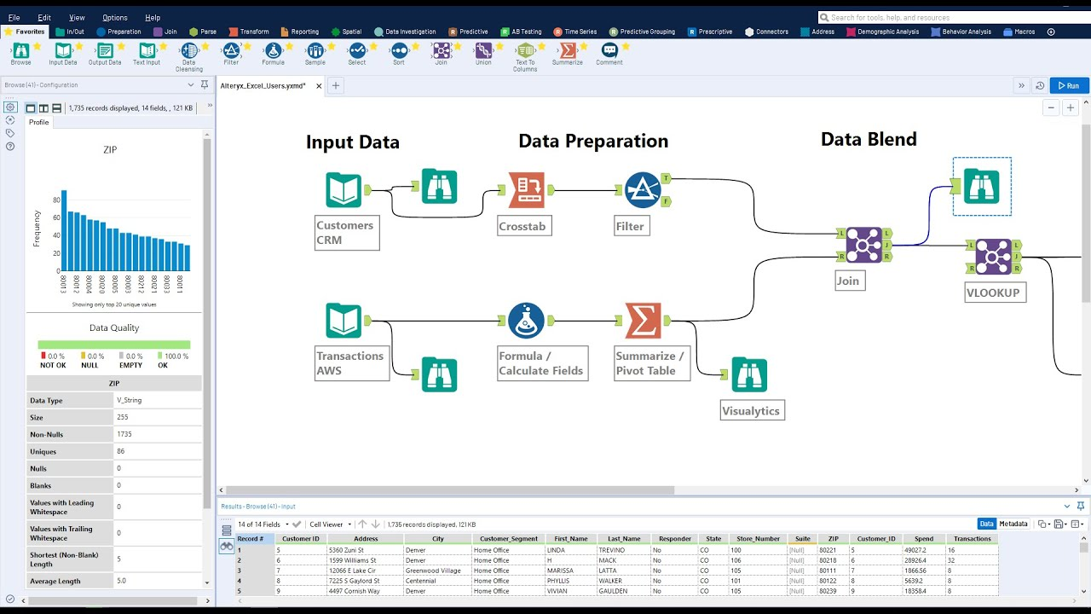

Workflow GUI

Slide 8
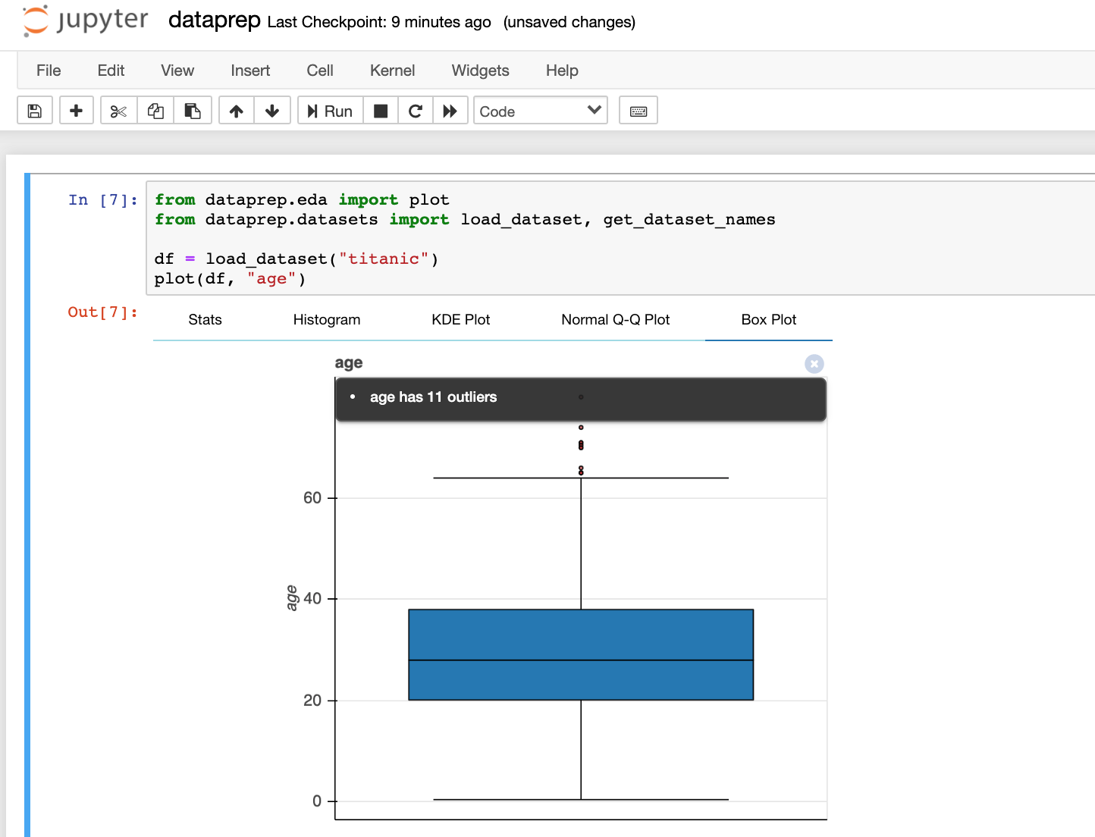

Notebook GUI

Slide 9
Which Direction To Go?
“
Data Prep Market was valued at USD 3.29 Billion in 2019 and is projected to reach USD 18.11 Billion by 2027, growing at a CAGR of 25.64% from 2020 to 2027
”
Source: https://www.verifiedmarketresearch.com/product/data-prep-market/
Three Directions
Spreadsheet GUI
Workflow GUI
Notebook GUI
Targeted at non-programmers
Targeted at data scientists

Slide 10
Data Preparation Tasks
Data Collection
Data Cleaning
Data Integration

Slide 11
Data Preparation Tasks
Data Collection
Where to collect
How to collect
Data Cleaning
Data Integration

Slide 12
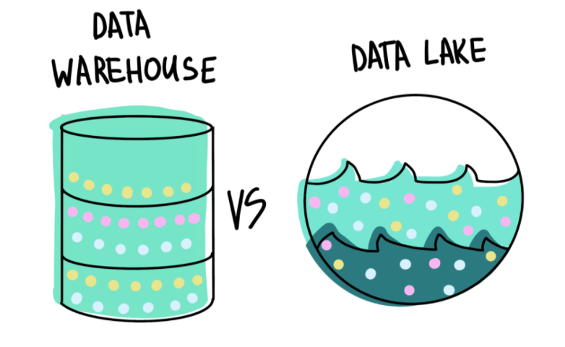
Where to Collect?
Internal Data
Data Warehouse (Tabular Data)
System Logs (Text Files)
Documents (Word, Excel, PDF)
Multimedia Data (Video, Audio, Image)

Slide 13
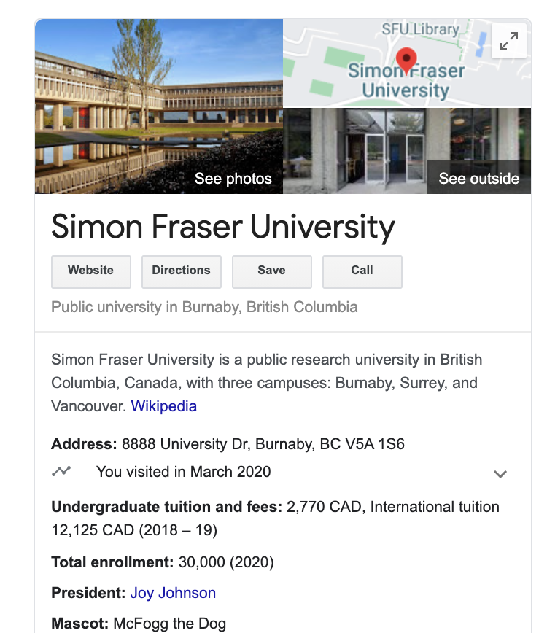
Where to Collect?
External Data
Web Pages
Web APIs (https://github.com/public-apis/public-apis)
Open Data (data.vancouver.ca, www.data.gov)
Knowledge Graph (Wikidata, Freebase)

Slide 14
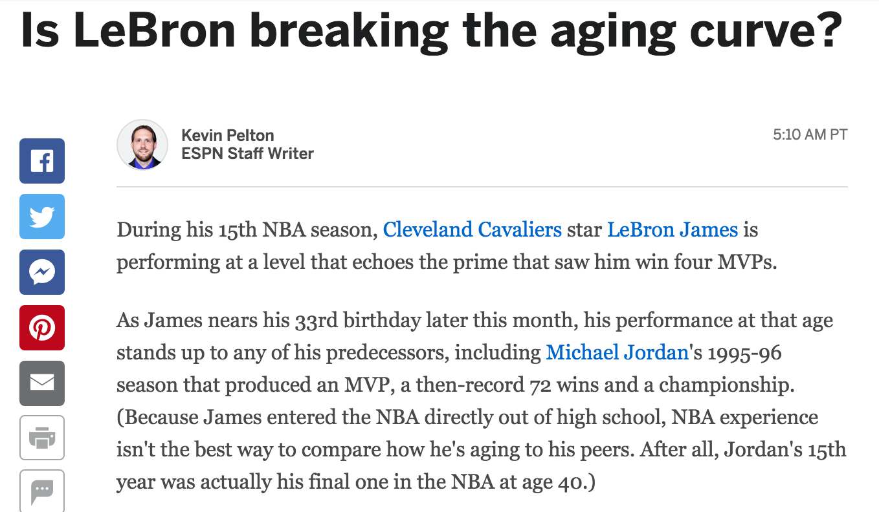
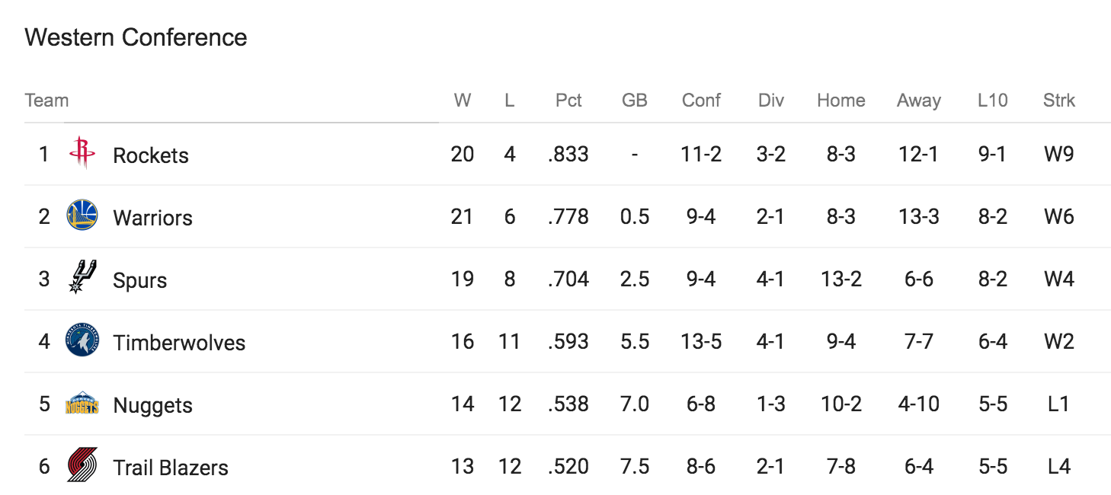
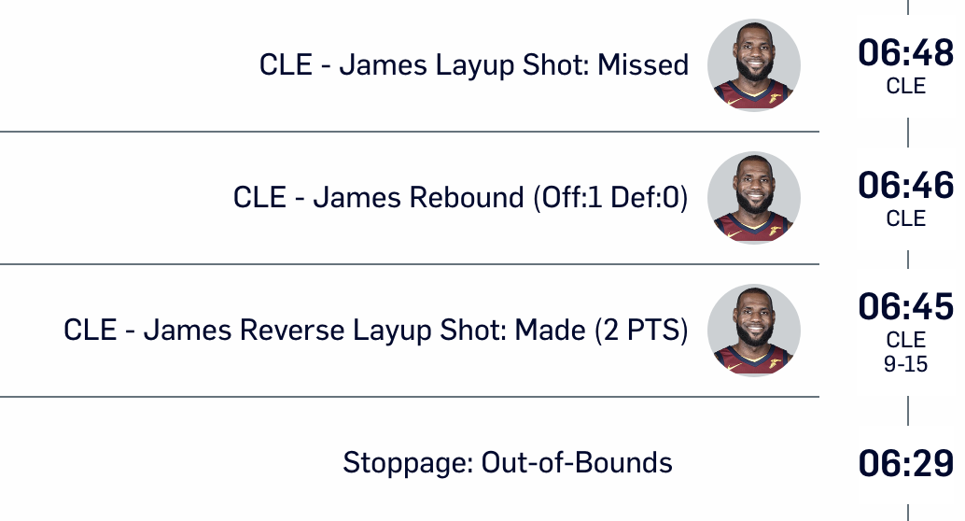
Data Classification
Data
Structured
Semi-structured
Unstructured

Slide 15
Challenges
Data Discovery
How to find related data?
Data Privacy
How to protect user privacy?
Security
How to avoid a data breach?
Domain knowledge
Information retrieval skills
Data masking
Differential privacy
Follow data access rules
Encrypt highly confidential data

Slide 16
Getting Data
From CSV Files
From JSON Files
From the Web
From HDFS
From Databases
From S3
From Web APIs

Slide 17
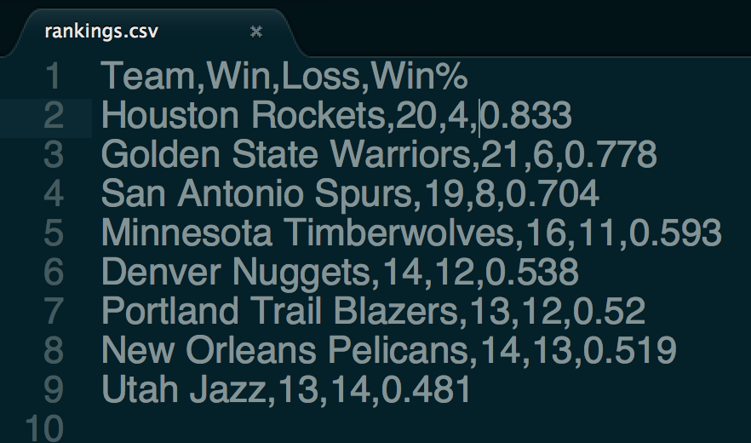
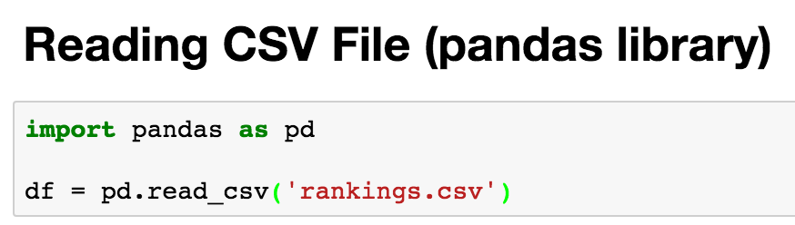
Load Data From CSV Files
CSV is a file format for storing tabular data

Slide 18
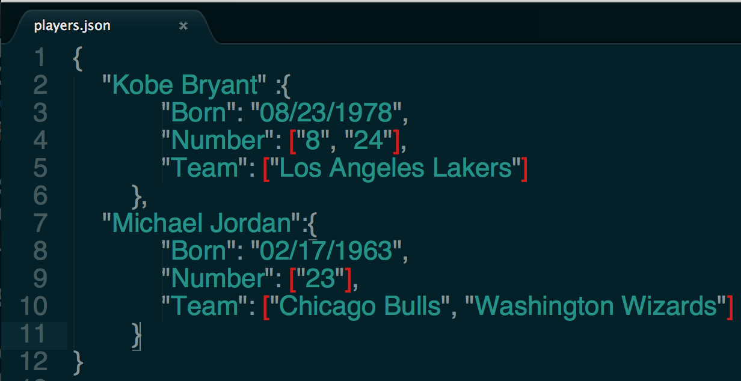
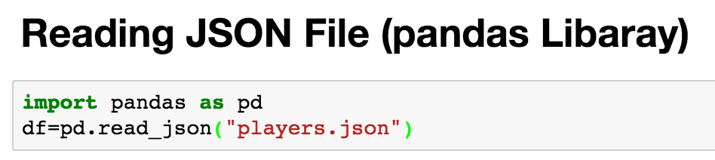
Load Data From JSON Files
JSON is a file format for storing nested data (array, dict)

Slide 19
Web Scraping
Open web pages
urllib2 (https://docs.python.org/2/library/urllib2.html)
request (http://docs.python-requests.org/en/master/)
Parse web pages
Beautiful Soup (https://www.crummy.com/software/BeautifulSoup/)
lxml (http://lxml.de/)
Putting everything together
Scrapy (https://scrapy.org/)

Slide 20
Before you scrape
Check to see if CSV, JSON, or XML version of an HTML page are available – better to use those
Check to see if there is a Python library that provides structured access (e.g., dataprep)
Check that you have permission to scrape
From “Deb Nolan. Web Scraping & XML/Xpath”

Slide 21

If you do scrape
Be careful to not to overburden the site with your requests
Test code on small requests
Save the results of each request so you don’t have to repeat the request unnecessarily
CAPTCHA
From “Deb Nolan. Web Scraping & XML/Xpath”

Slide 22
Outline
Data Collection
Data Cleaning
Dirty Data Problems
Data Cleaning Tools
Example: Outlier Detection
Data Integration

Slide 23
Dirty Data Problems
From Stanford Data Integration Course:
Parsing text into fields (separator issues)
Missing required field (e.g. key field)
Different representations (iphone 2 vs iphone 2nd generation)
Fields too long (get truncated)
Formatting issues – especially dates
Outliers (age = 120)

Slide 24
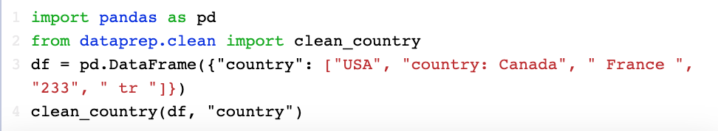
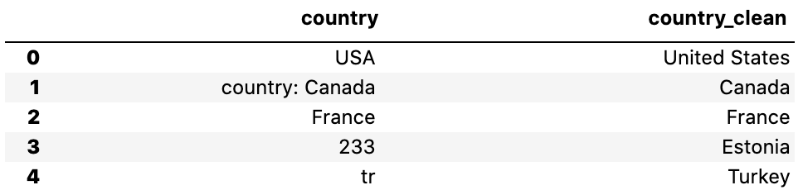
Data Cleaning Tools
Python
Missing Data (Pandas)
Deduplication (Dedup)
OpenRefine
Open-source Software (http://openrefine.org)
OpenRefine as a Service (RefinePro)
Data Wrangler
The Stanford/Berkeley Wrangler research project
Commercialized (Trifacta)
Not Many Tools.
That’s why we are building DataPrep (http://dataprep.ai)

Slide 25
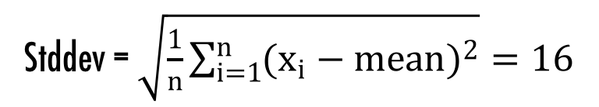

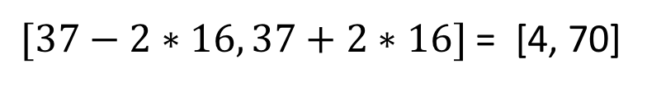
Outlier Detection
The ages of employees in a US company
1 20 21 21 22 26 33 35 36 37 39 42 45 47 54 57 61 62
Mean = $\frac{1}{n}\sum_{i=1}^{n}{x_{i}=37}$
$[37−2∗16, 37+2∗16]$ = [4, 70]
Stddev = $\sqrt{\frac{1}{n}\sum_{i=1}^{n}{{(x_{i}−mean)}^{2}}}=16$

Slide 26
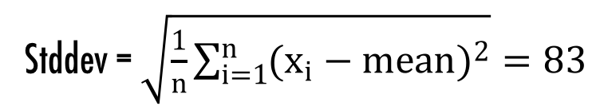

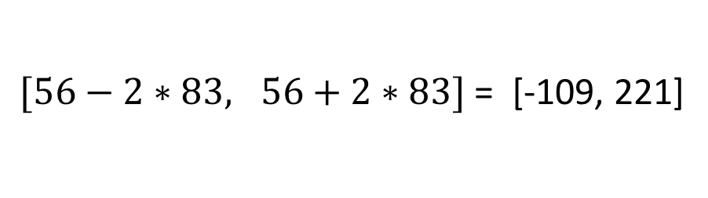
Outlier Detection
The ages of employees in a US company
1 20 21 21 22 26 33 35 36 37 39 42 45 47 54 57 61 62 400
Mean = $\frac{1}{n}\sum_{i=1}^{n}{x_{i}=56}$
$[56−2∗83, 56+2∗83]$ = [-109, 221]
Stddev = $\sqrt{\frac{1}{n}\sum_{i=1}^{n}{{(x_{i}−mean)}^{2}}}=83$

Slide 27
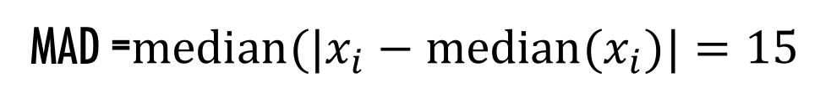
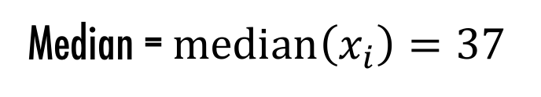
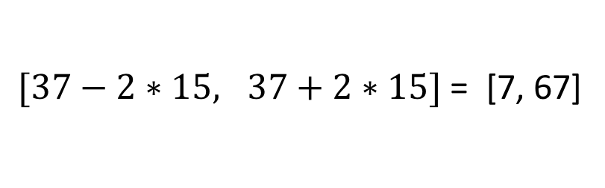
Outlier Detection
The ages of employees in a US company
1 20 21 21 22 26 33 35 36 37 39 42 45 47 54 57 61 62 400
Median = $median\left(x_{i}\right)=37$
$[37−2∗15, 37+2∗15]$ = [7, 67]
MAD =$median(|x_{i}−median(x_{i})|=15$

Slide 28
Data Preparation Tasks
Data Collection
Data Cleaning
Data Integration
Data Integration Problem
Three Steps (Schema Matching, Entity Resolution, Data Fusion)
Example: Entity Resolution

Slide 29
Data Integration Problem
Data Source 1 (from CourSys)
Data Source 2 (from survey)
First Name | Last Name | Mark
Michael | Jordan | 50
Kobe | Bryant | 48
Name | Background
Mike Jordan | C++, CS, 4 years
Kobe Bryant | Business, 2 years
Data Integration???
Name | Mark | Background
Michael Jordan | 50 | C++, CS, 4 years
Kobe Bryant | 48 | Business, 2 years
Integrated Data

Slide 30
Data Integration: Three Steps
Schema Mapping
Creating a global schema
Mapping local schemas to the global schema
Entity Resolution
You will learn this in detail later
Data Fusion
Resolving conflicts based on some confidence scores
Want to know more?
Anhai Doan, Alon Y. Halevy, Zachary Ives. Principles of Data Integration. Morgan Kaufmann Publishers, 2012.

Slide 31
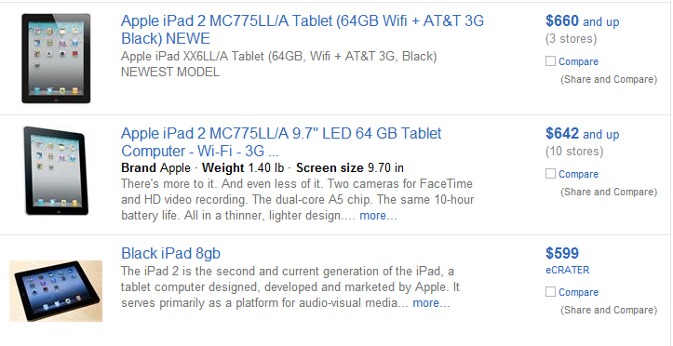
Entity Resolution

Slide 32
Output of Entity Resolution
ID | Product Name | Price
r₁ | iPad Two 16GB WiFi White | $490
r₂ | iPad 2nd generation 16GB WiFi White | $469
r₃ | iPhone 4th generation White 16GB | $545
r₄ | Apple iPhone 3rd generation Black 16GB | $375
r₅ | Apple iPhone 4 16GB White | $520
(r₁, r₂)
, (r₃, r₅)

Slide 33
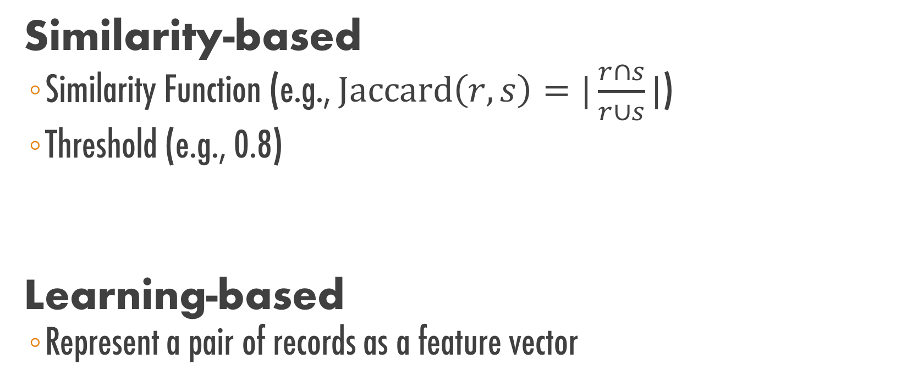
Entity Resolution Techniques
Similarity-based
Similarity Function (e.g., $\text{Jaccard}\left(r, s\right)=|\frac{r∩s}{r∪s}|$)
Threshold (e.g., 0.8)
Learning-based
Represent a pair of records as a feature vector
Jaccard(r1, r2) = 0.9 ≥ 0.8 Matching
Jaccard(r4, r8) = 0.1 < 0.8 Non-matching

Slide 34

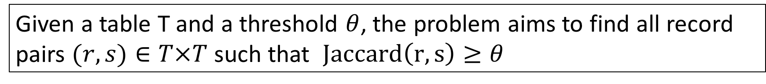
Similarity-based
Suppose the similarity function is Jaccard.
Problem Definition
Given a table T and a threshold $θ$, the problem aims to find all record pairs $(r,s)∈T×T$ such that $Jaccard\left(r, s\right)≥θ$
The naïve solution needs $n^{2}$ comparisons

Slide 35
Filtering-and-Verification
Step 1. Filtering
Removing obviously dissimilar pairs
Step 2. Verification
Computing Jaccard similarity only for the survived pairs

Slide 36
How Does Filtering Work?
What are “obviously dissimilar pairs”?
Two records are obviously dissimilar if they do not share any word.
In this case, their Jaccard similarity is zero, thus they will not be returned as a result and can be safely filtered.
How can we efficiently return the record pairs that share at least one word?
To help you understand the solution, let’s first consider a simplified version of the problem, which assumes that each record only contains one word
Notes:
obviously dissimilar pairs

Slide 37
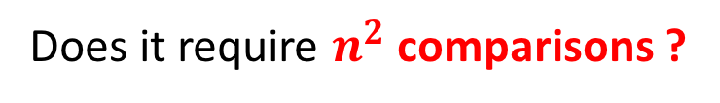
A simplified version
Suppose each record has only one word. Write an SQL query to do the filtering.
r₁
Apple
Apple
Banana
Orange
Banana
SELECT T1.id, T2.id
FROM Table T1, Table T2
WHERE T1.word = T2.word and T1.id < T2.id
r₂
r₃
r₄
r₅
Does it require $n^{2}$ comparisons ?
Output: (r1, r2), (r3, r5)

Slide 38
A general case
Suppose each record can have multiple words.
r₁
Apple
Orange
Apple
Banana
Orange
Apple
Banana
r₁
r₁
Apple, Orange
Apple
Banana
Orange, Apple
Banana
r₂
This new table can be thought of as the inverted index of the old table.
r₂
r₃
Flatten
Run the previous SQL on this new table and remove redundant pairs.
r₃
r₄
r₄
r₄
r₅
r₅

Slide 39
Not satisfied with efficiency?
Exploring stronger filter conditions
Filter the record pairs that share zero token
Filter the record pairs that share one token
….
Filter the record pairs that share k tokens
Challenges
How to develop efficient filter algorithms for these stronger conditions?
Jiannan Wang, Guoliang Li, Jianhua Feng.
Can We Beat The Prefix Filtering? An Adaptive Framework for Similarity Join and Search. SIGMOD 2012:85-96.

Slide 40
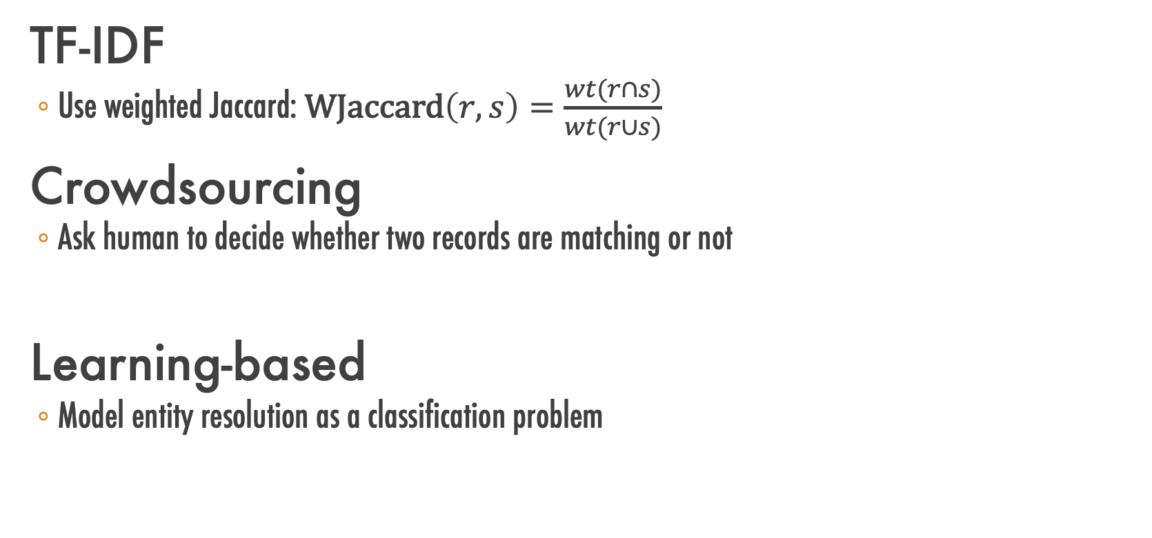
Not satisfied with result quality?
TF-IDF
Use weighted Jaccard: $\text{WJaccard}\left(r, s\right)=\frac{wt(r∩s)}{wt(r∪s)}$
Crowdsourcing
Ask human to decide whether two records are matching or not
Learning-based
Model entity resolution as a classification problem

Slide 41
Crowdsourcing
CMPT 884: Human-in-the-loop Data Management (SFU, Fall 2016)
https://sfu-db.github.io/cmpt884-fall16/

Slide 42


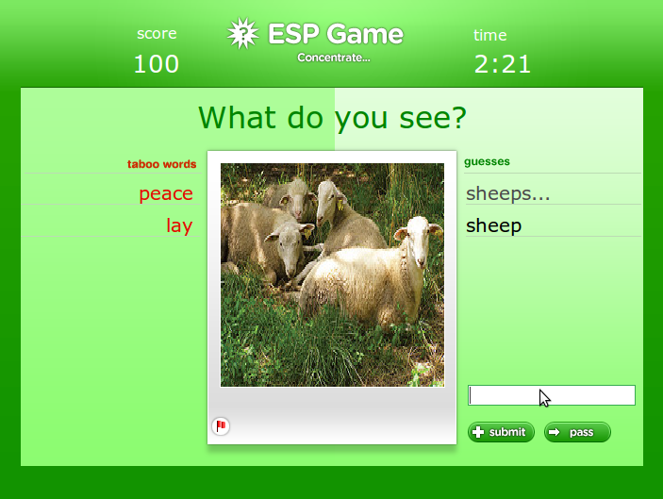
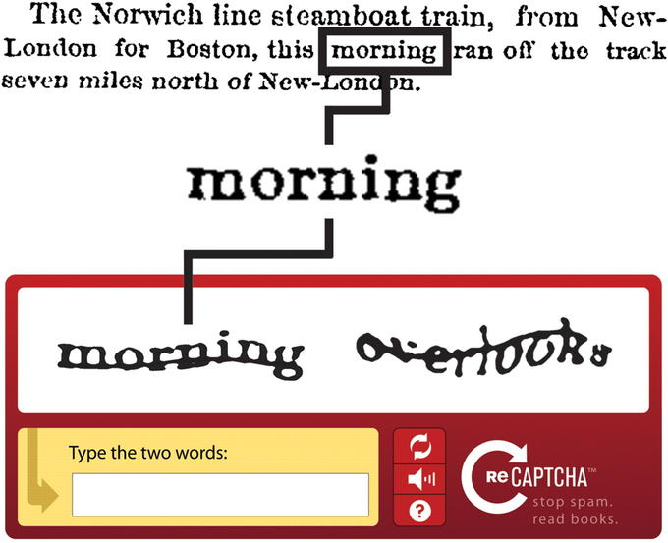
The Wisdom of Crowds
What does it mean?
Two heads are better than one
Some famous examples

Slide 43







Crowdsourcing Platforms

Slide 44



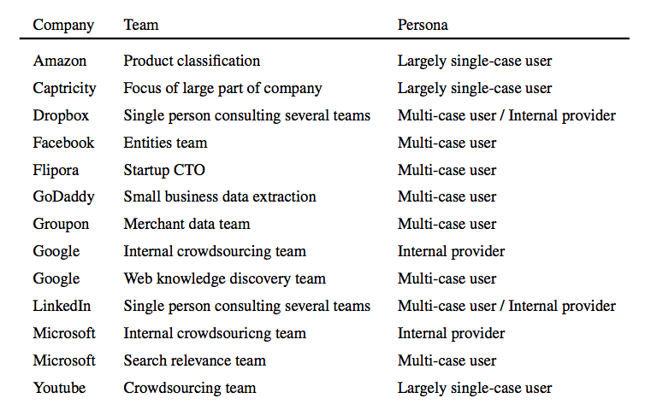








Industrial Survey
Adam Marcus, Aditya Parameswaran. Crowdsourced Data Management: Industry and Academic Perspectives. FTDB 2015

Slide 45
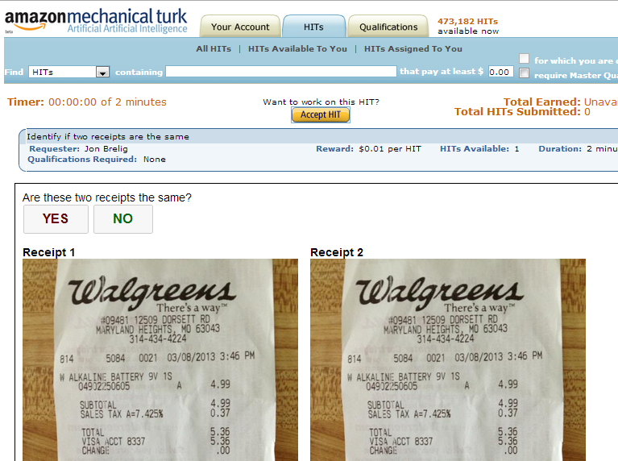
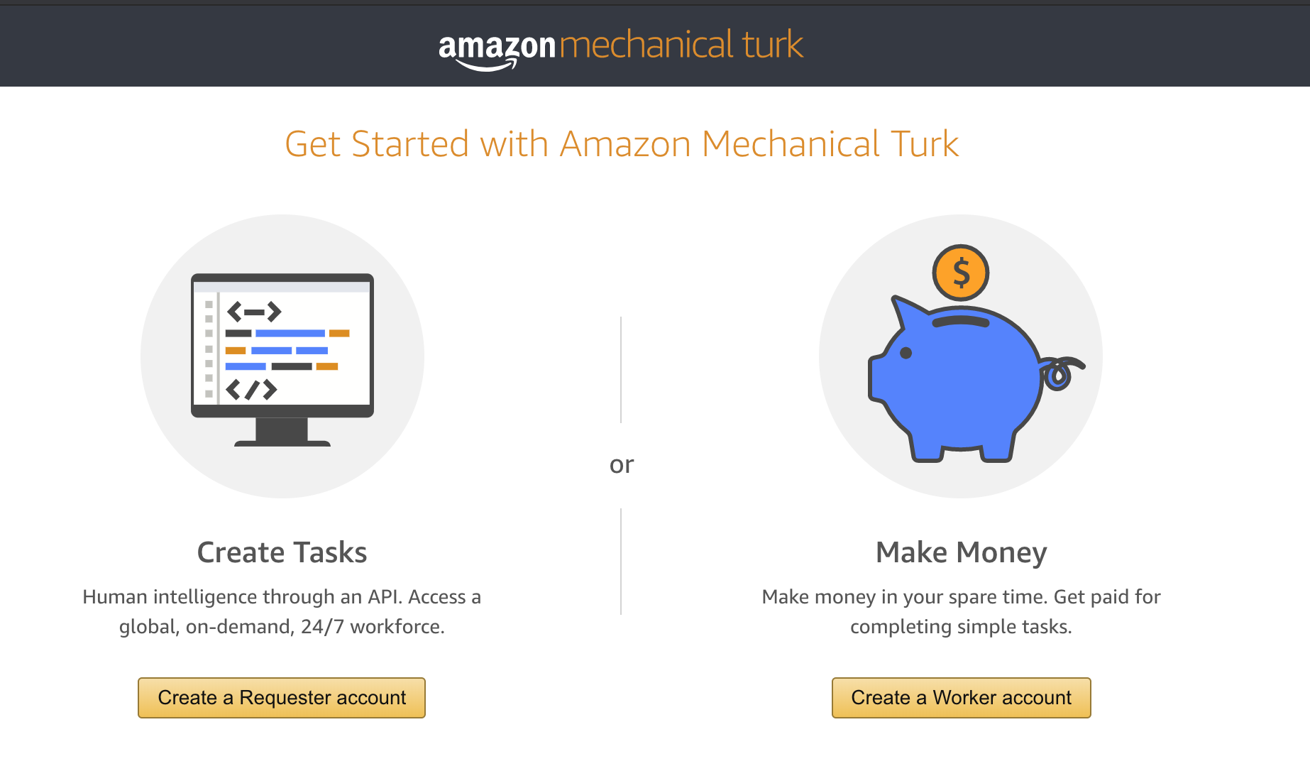
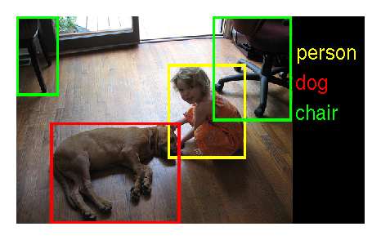
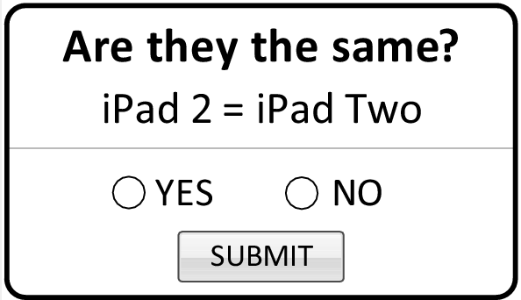
Amazon Mechanical Turk
500K+ workers*
* https://requester.mturk.com/tour

Slide 46
Use Cases
Use Cases | # Participants
Classification | 12
Entity resolution | 6
Data cleaning | 5
Ranking | 5
Spam detection | 5
Data extraction | 5
Text generation | 5

Slide 47
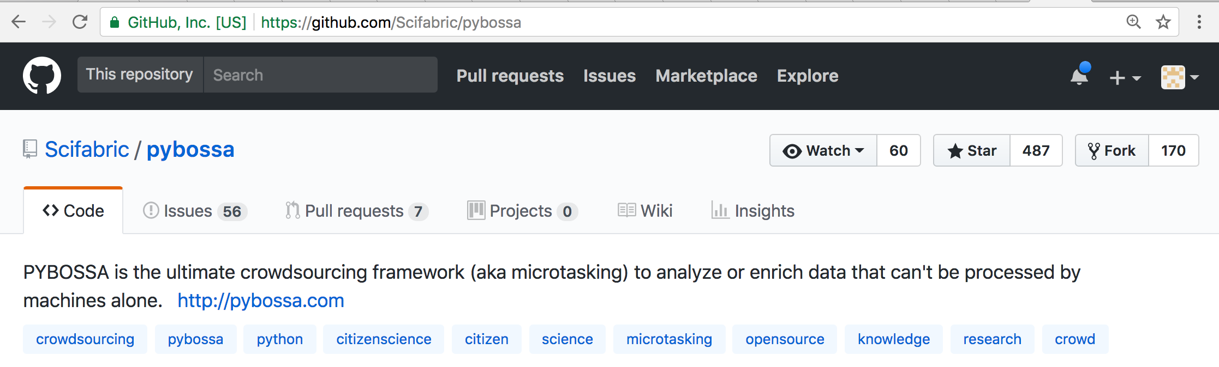
Crowdsourcing may not work ☹
What if your data is confidential?
E.g., Medical Data, Customer Data
Internal Crowdsourcing Platform

Slide 48
Crowdsourcing may not work ☹
What if your data is so big?
E.g., Label 10 million images
Active Learning

Slide 49
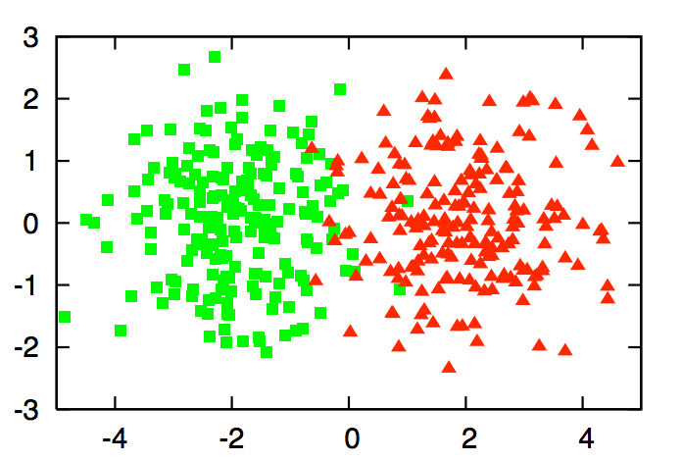
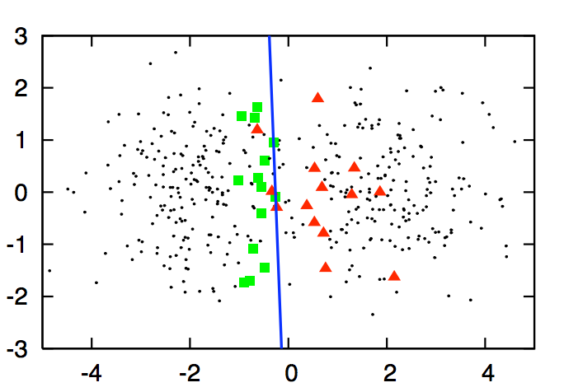
Active Learning
Supervised Learning
Active Learning

Slide 50
Workflow
Supervised Learning
Active Learning
Labeled
Data
Data
Labeled
Data
Data
Labeled
Data
Model
Model

Slide 51
Query Strategy
Which data points should be labeled?
Uncertain Sampling
Query-By-Committee
Expected Error Reduction
Expected Model Change
Variance Reduction
Density-Weighted Methods
Settles, Burr. "Active learning literature survey." University of Wisconsin, Madison 52.55-66 (2010): 11.

Slide 52
Uncertain Sampling
Pick up most uncertain data points to label
Logistic Regression
predict_proba(X)
52%
98%

Slide 53
Summary
Preppin' Data
A weekly challenge to help you learn to prepare data and use Tableau Prep
https://preppindata.blogspot.com/
Data Collection
Where to collect, How to Collect
Data Cleaning
Dirty Data Problems, Data-cleaning tools
Data Integration
Schema Mapping, Entity Resolution, Data Fusion
Entity Resolution
Similarity-based, Crowdsourcing, Active Learning

